Slide 1
ISTQB FOUNDATION LEVEL
Chapter 1: Fundamentals of Software Testing
Core definitions, objectives, principles, lifecycle activities, and essential engineering practices.

Slide 2

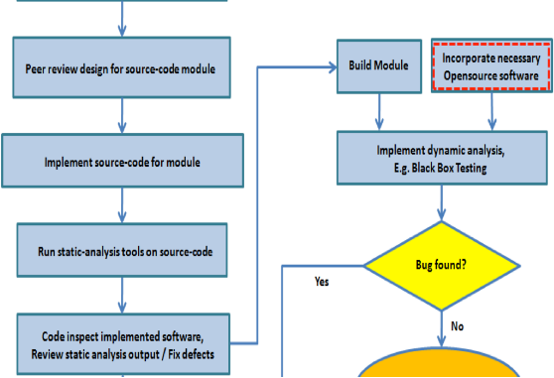
1.1 CORE CONCEPTS
What is Software Testing?
Systematic Evaluation
Assesses software quality and verifies compliance with specified functional requirements.
Dynamic Execution
Executes software code with real input data to observe runtime behavior and operational failures.
Static Analysis
Reviews requirements, user stories, and source code without executing the program.

Slide 3


1.1 DISTINCT DISCIPLINES
Testing vs. Debugging
Software Testing
Debugging
Discovers software defects and evaluates system conformity.
Locates, fixes, and verifies resolution of root code errors.
Action: Executes or reviews work products
Action: Investigates code logic issues
Goal: Reveals system failures
Goal: Eliminates defect causes
Role: Test Engineers & Analysts
Role: Software Developers

Slide 4



1.1 CORE GOALS
Primary Objectives of Testing
Defect Discovery
Risk Reduction
Quality Evidence
Compliance
Prevents bugs from reaching live production.
Lowers financial and operational failure hazards.
Builds stakeholder confidence through transparent metrics.
Ensures adherence to legal and regulatory standards.

Slide 5
1.1 QUALITY PERSPECTIVES
Verification vs. Validation
VERIFICATION
VALIDATION
"Are we building the product right?"
"Are we building the right product?"
Checks if work products conform to documented specifications.
Evaluates whether the system fulfills actual user operational needs.
Static techniques: Reviews, walkthroughs, inspections
Dynamic techniques: User acceptance, live environment testing

Slide 6
1.2 FAILURE MECHANICS
Errors, Defects, and Failures
1
2
3
Error (Mistake)
Defect (Bug / Fault)
Failure
Human action producing incorrect code or design.
Code flaw created by human mistake.
System deviation from required operational behavior.

Slide 7
1.2 QUALITY MANAGEMENT
Quality Assurance vs. Software Testing
Dimension | Quality Assurance (QA) | Software Testing
Orientation | Process-oriented focus | Product-oriented focus
Primary Goal | Defect prevention via standard audits | Defect identification via system execution
SDLC Scope | Entire organizational lifecycle | Specific test design and execution phases

Slide 8
1.3 UNIVERSAL RULES
7 Fundamental Testing Principles
1. Shows presence of defects: Proves bugs exist, not defect absence.
5. Pesticide paradox: Repeated tests lose defect-finding power.
2. Exhaustive testing impossible: Risk and priorities guide test depth.
6. Context dependent: Medical software requires different techniques than games.
3. Early testing saves money: Catches errors at lowest repair cost.
7. Absence-of-errors fallacy: Bug-free code fails if user needs are unmet.
4. Defects cluster together: 80% of bugs sit in 20% of modules.

Slide 9
1.4 LIFECYCLE ACTIVITIES
The Test Process Workflow
STAGE 1
STAGE 2
STAGE 3
STAGE 4
STAGE 5
STAGE 6
Planning
Analysis
Design
Implementation
Execution
Completion
Scope & approach
Test basis review
Test cases creation
Suite setup
Run & log bugs
Metrics & archiving

Slide 10


1.4 WORK PRODUCTS & TEAM
Testware & Tester Roles
Testware Artifacts
Test Plans, Traceability Matrices, Test Cases, Automated Scripts, and Defect Summary Reports created during testing.
Test Management Role
Oversees strategy design, resource allocation, monitoring, and cross-team communication.

Slide 11




1.5 COMPETENCIES
Essential Tester Skills
Communication
Critical Thinking
Technical Skills
Domain Knowledge
Clear defect reporting and risk presentation.
Challenging implicit assumptions and edge cases.
Automation frameworks, SQL, and API validation.
Understanding business workflows and regulatory constraints.

Slide 12
END OF CHAPTER 1
Questions & Discussion
Quality is a shared responsibility across the entire development team.
Next: Chapter 2 - Testing Throughout the SDLC

Slide 13


Image Sources
http://www.todaysoftmag.ro/tsm/images/articles/tsm24/a61.png
Source: www.todaysoftmag.com
https://framerusercontent.com/images/ymHQZhV9JyNJjctX1lI785VpWw.png?width=1408&height=768
Source: www.selementrix.ch

